Slide 1
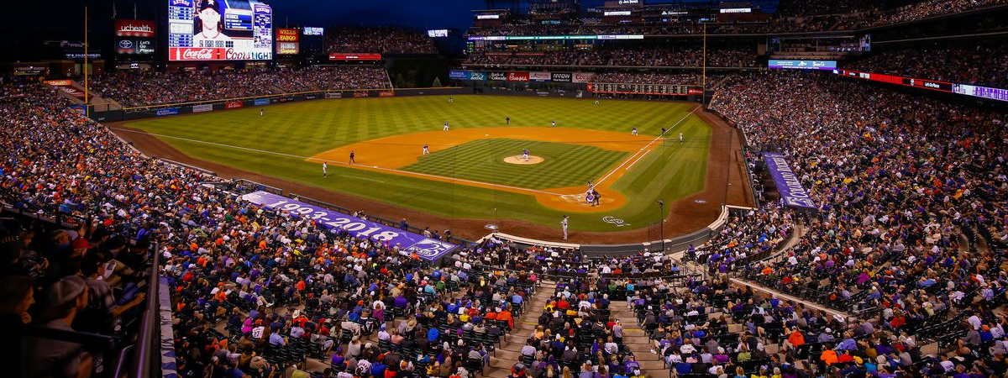
Bettin with Breton
Atmospheric Conditions and their impact on runs scored at Coors Field

Slide 2


Why Coors Field?
Since its inception in 1995, Coors has been feared by pitchers and praised by hitters
Typically Over/Under totals for MLB hover in the 6-8 range, Coors consistently in the 11 plus range
Thin air increases ball flight
Dry air hardens baseballs making them more elastic when they hit a bat thus adding to exit velocity
Seams do not catch thin mountain air as much as they do at sea level, thus breaking pitches lose much of their break as well as the pitchers ability to control them (more to come on this in Practicum 2!)
Notes:
May require more than one slide

Slide 3
Extracting Data
Baseball Data
Utilize www.baseball-reference.com
Pull every game the Rockies have played
Data includes
RA=Runs Against
R=Runs For
Home/Away
Starting Pitchers (will utilize in Practicum 2)
Date
Day/Night
Atmospheric Conditions
Utilize
https://www.wunderground.com
Pull atmospheric data for corresponding data for dates of games
Pull hourly data to adjust to Day/Night Games
Notes:
May require more than one slide

Slide 4
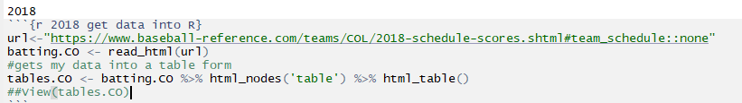
Baseball Data Pull
Initial Code to grab data from www.baseball-reference.com
This code tells R to go to the URL then read the HTML table which the desired data rests
Converts the data into a HTML Table which is more easily manipulated within R
Notes:
May require more than one slide

Slide 5
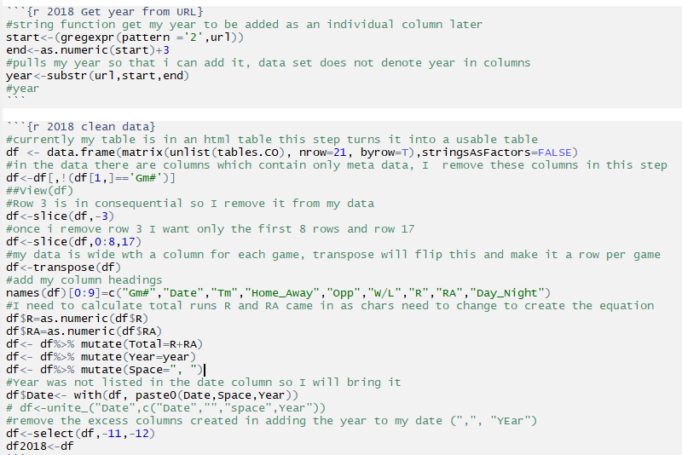
Baseball Data Clean
The data in its inherit form is fairly messy and unable to be used for analysis, so I had to clean it and get it and format which could be joined to my weather data set
Notes:
May require more than one slide

Slide 6
Baseball Data Clean
The data in its inherit form is fairly messy and unable to be used for analysis, so I had to clean it and get it and format which could be joined to my weather data set
Notes:
May require more than one slide

Slide 7
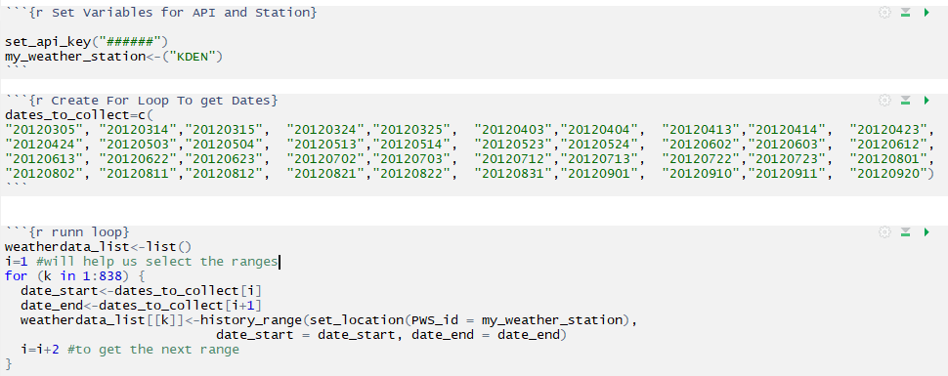
Extracting Weather Data
Utilize wunderground package and an API I was able to receive from a work colleague (Weather Channel is an IBM Company)
(rpubs.com, 2018)
Notes:
May require more than one slide

Slide 8
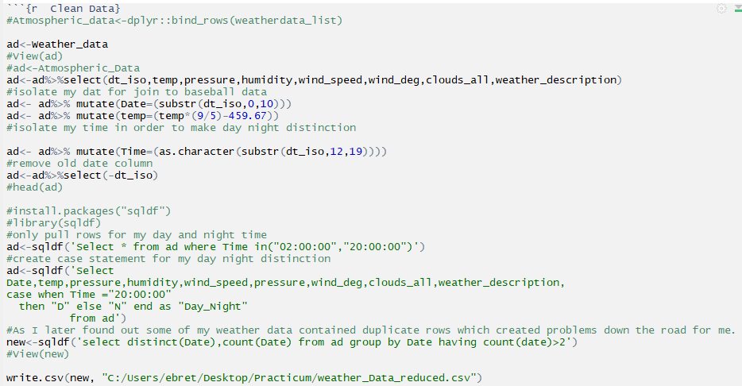
Weather Data Clean
The data in its inherit form is fairly messy and unable to be used for analysis, pulled only two times 2:00 and 8:00 roughly times for day and night games
Notes:
May require more than one slide

Slide 9
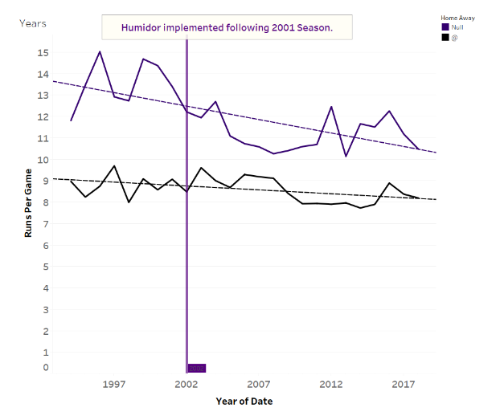
Runs by Year Home vs Away
Baseball E.D.A
Large gap between Home and Away

Slide 10
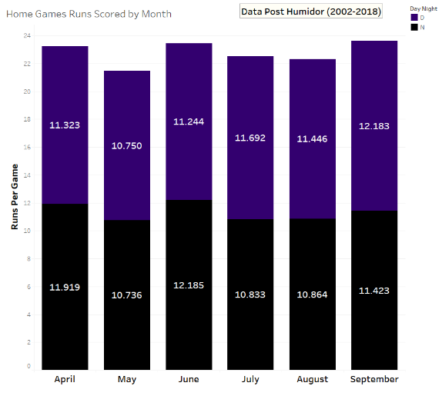
Runs by Month and Day/Night
Baseball E.D.A

Slide 11
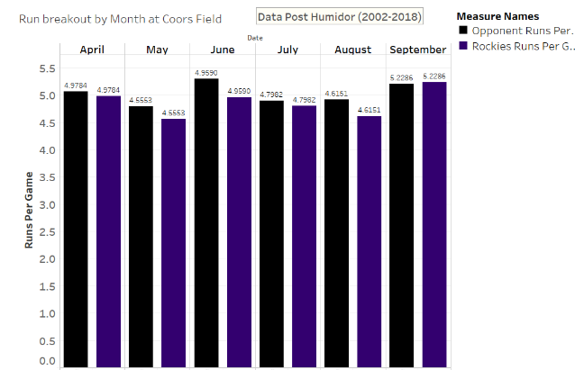
Runs by Opponent/ Rockies
Baseball E.D.A

Slide 12
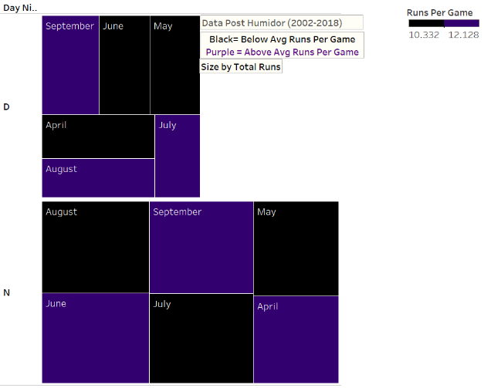
Runs by Month and Day/Night
Baseball E.D.A

Slide 13
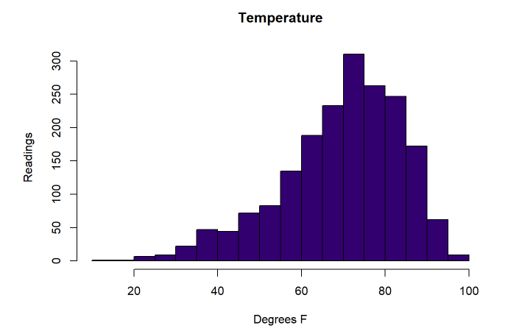
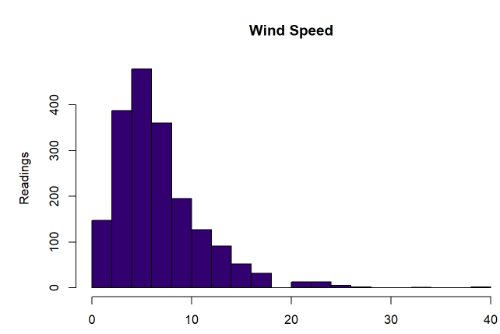
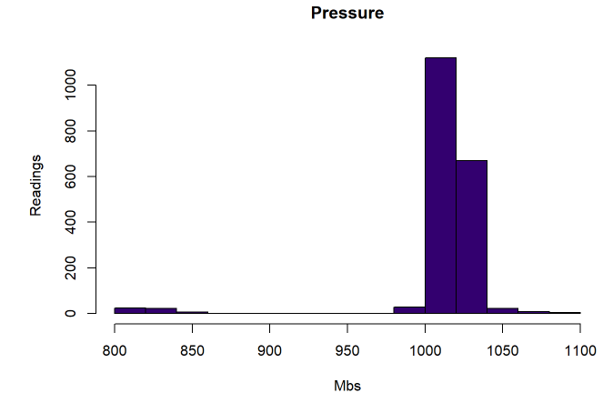
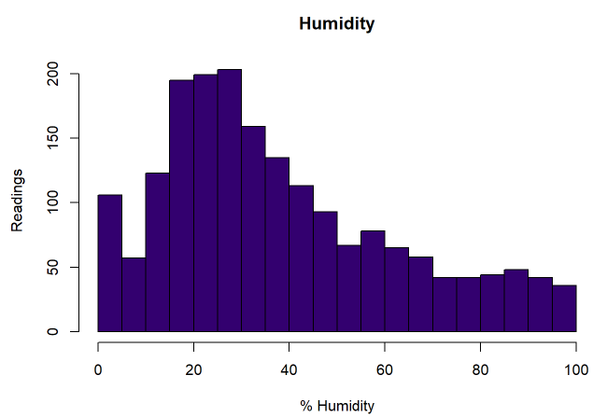
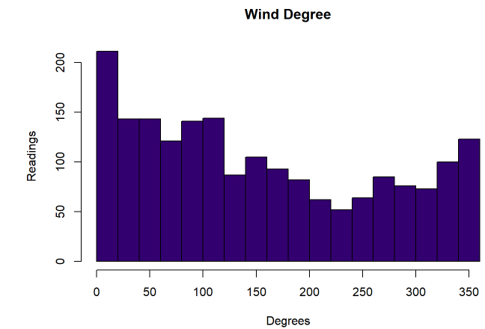
Histograms
Weather E.D.A

Slide 14
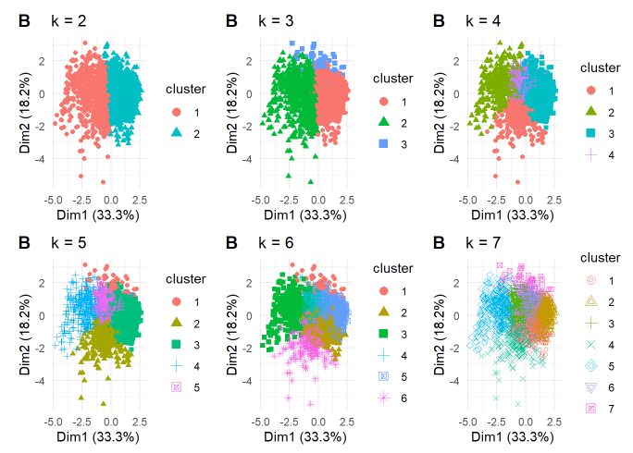
Clustering
Weather E.D.A
Scaled all my data so that calculated distances would not be skewed based on different measurement types
Added back my Date+Day_Night as it is my primary key and required to get back to baseball data
Ran for multiple different values of K
Graphed outputs

Slide 15
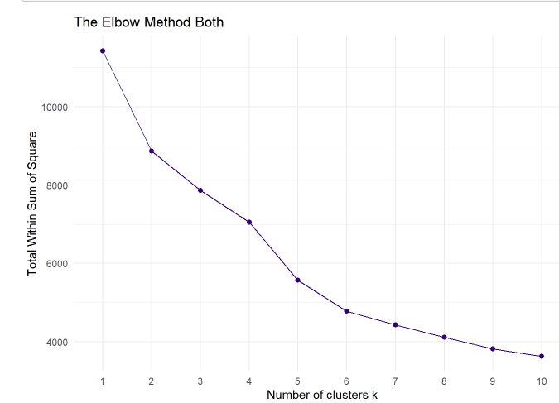
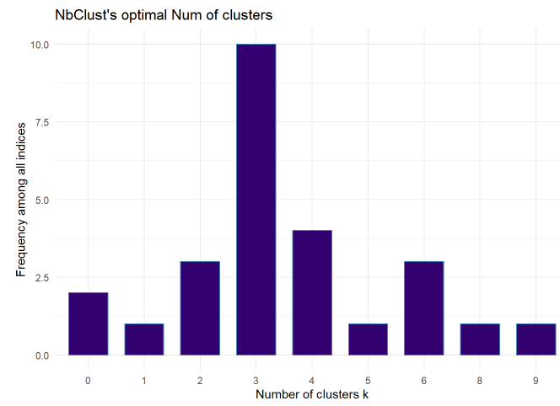
Determining K
3= Optimum Value of Clusters
Elbow Method
N Bust
(Matt.0, 2019)
Notes:
May require more than one slide

Slide 16
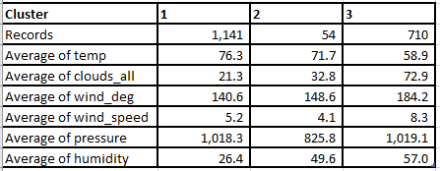
Clusters K=3
Findings
Unfortunately clusters did not produce distinct weather types as I had hoped (need more data)
This was especially true when data was reduced on the join to my baseball data set
Notes:
May require more than one slide

Slide 17
Combining the data set
Both date sets cleaned and explored, now bring the two together
Issue number one, I only had 5 years of atmospheric data and some dates were missing in the most recent 5 years
Total combined data set 405 records
Will continue to explore new ways of atmospheric data obtaining
Notes:
May require more than one slide

Slide 18
Testing the Data Set
Ran Density Plots for all measures
Ran Histograms for all measures
Ran QQ Plots for all measures
Performed Shapiro Test on all measures
Concluded that data was not normally distributed therefore, I would have to use a Non Parametric means of predictive analytics
Notes:
May require more than one slide

Slide 19
KNN Classifier
I chose to use KNN Classifier for a variety of reasons
Of all the machine learning methods, I had the best grasp of KNN from a theoretic perspective
All my measures were integers, so it made distance calculation easier without the hassle of conversion
No need to tune complex parameters just find the optimal value for K
Notes:
May require more than one slide

Slide 20
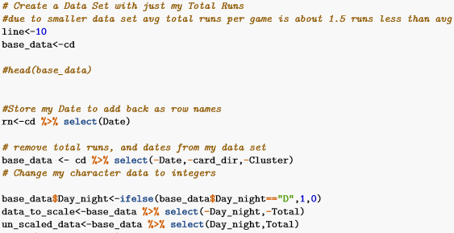
KNN Classifier
Ability to move my line was critical to my project as Over/Under lines change by the game, this gives my model flexibility, though it does require me to reassess optimal values for K.
Notes:
May require more than one slide

Slide 21
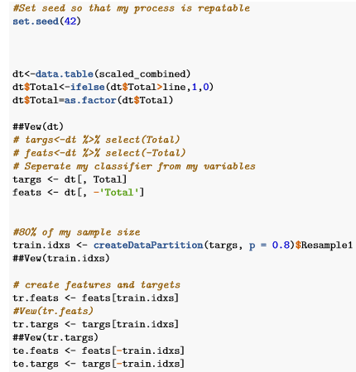
Running the Code
Dividing my data into training and testing
Separating my targets from my features
Notes:
May require more than one slide

Slide 22
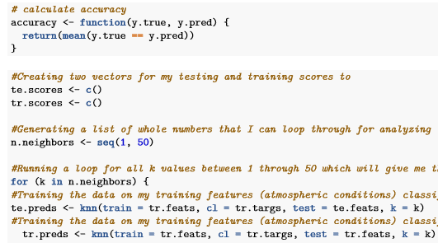
Running the Code
Create function to help measure accuracy
Run for all values of K for target features on target predictors
Run for all values of K for target features on test predictors
Notes:
May require more than one slide

Slide 23
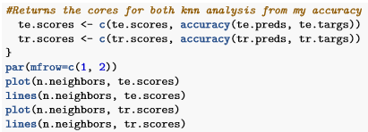
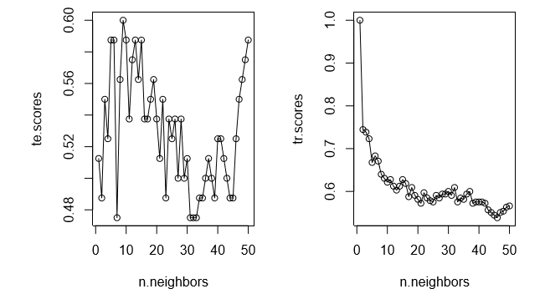
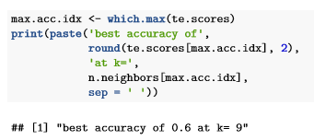
Running the Code
Notes:
May require more than one slide

Slide 24
Cross Validation Results
Additionally ran K means 5 fold cross validation
Ran on training data set as well as the entire data set
Averaged an optimal number of k between 7 and 9 with an accuracy of about 57%
Notes:
May require more than one slide

Slide 25
How to Use Model
Adjust value for Line in R script
Add row of data for the game along with the corresponding atmospheric conditions for the game including day night
Notes:
May require more than one slide

Slide 26
Lessons Learned
There is no MAGIC BULLET
Think BIG than react small, focus on big trends, do not try to unlock minute mysteries
CHECK SOURCE DATA!
Incremental QA checks
Get more data, (I did correlation plots for my measures to runs but no trends, I think more data would have changed this)
Notes:
May require more than one slide

Slide 27
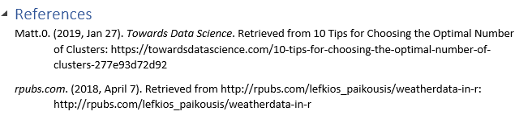
Works Cited
Notes:
May require more than one slide

